Slide 1
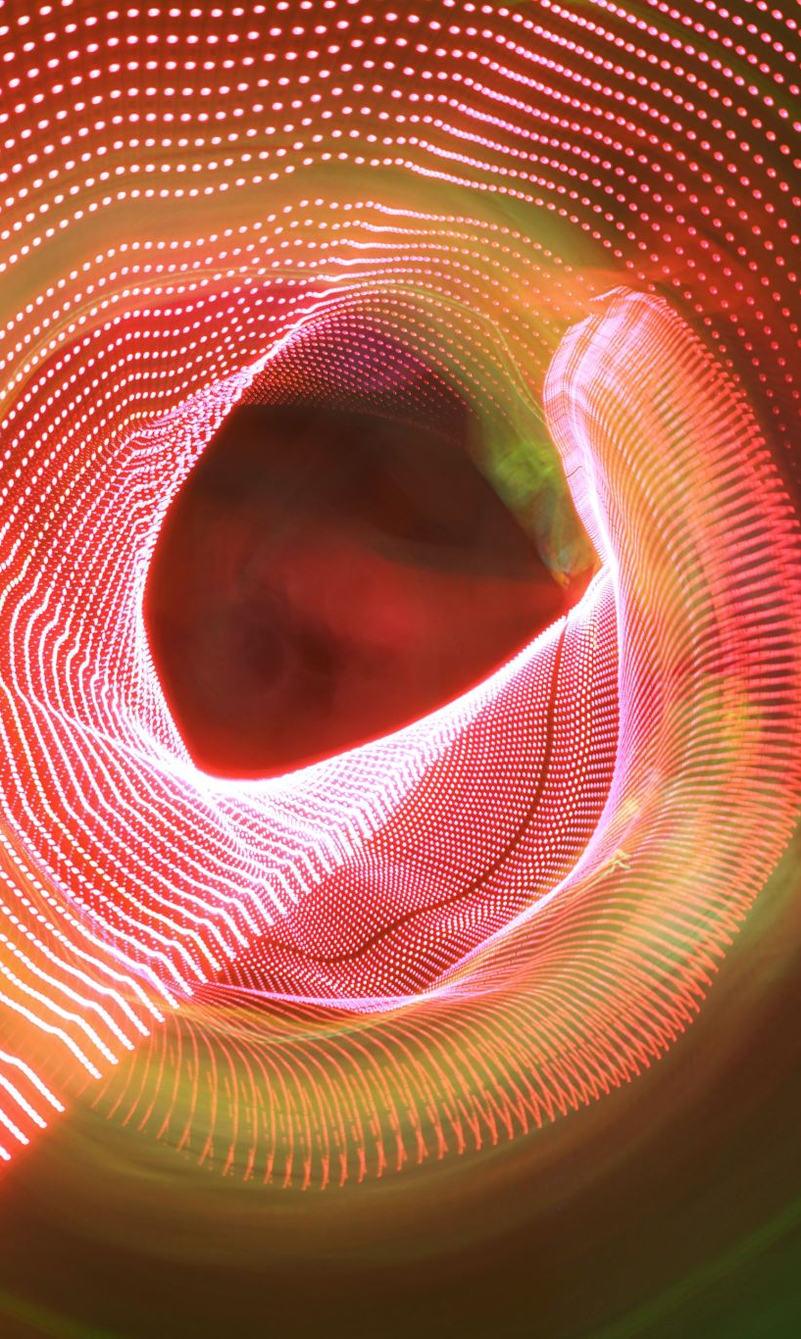
Radiation Therapy
Radiation Safety
PHYS307TH

Slide 2
Contents:
Radiation Therapy
Goals of Radiation Therapy
Types of Radiation Therapy
Side effects of Radiation Therapy

Slide 3
Radiation Therapy:
Uses high energy radiations , such as x-rays ,gamma rays , electron beams , protons to destroy cancer cells and shrink tumors
Also known as Radiation Oncology and Radiotherapy
Radiation works by making small breaks in the DNA inside cells . These breaks keep cancer cells from growing and dividing and cause them to die

Slide 4
Goals of Radiation Therapy:
To cure or shrink early- stage cancer
To stop cancer from coming back (recurring) somewhere else
To treat symptoms caused by advanced cancer
To treat cancer that has recurred

Slide 5
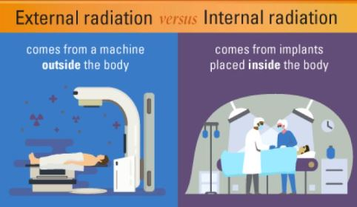
Types of Radiation Therapy:
External beam Radiation Therapy
Internal Radiation Therapy
Radioisotope or Radionuclide Therapy

Slide 6
Side effects of Radiation Therapy:
Short –term side effects
Long –term side effects

Slide 7
Short–term side effects:
Fatigue and lethargy
Skin irritation ,including swelling, blisters and sunburned or tanned appearance
Effects specific to area of treatment,such as hair loss,urinary problems nausea, vomiting and diarrhea
Tissue inflammation
Sometimes a drop in the number of white blood cells or platelets

Slide 8
Long –term side effects:
Stiffening and restricted movement
Skin effects
Diarrhea and bleeding
Hormone problems
A second cancer caused by radiation exposure

